Slide 1
Background Tasks
Android Developer Fundamentals
Lesson 8
This work is licensed under a Creative Commons Attribution-NonCommercial 4.0 International License

Slide 2
8.1 Notifications
This work is licensed under a Creative Commons Attribution-NonCommercial 4.0 International License

Slide 3
Contents
Notifications
Creating Notifications
Actions and Pending Intents
Priority and Defaults
Common Layouts
Managing Notifications

Slide 4
What Are Notifications?

Slide 5
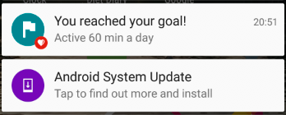
What is a notification?
Message displayed to user outside regular app UI
Small icon
Title
Detail text

Slide 6
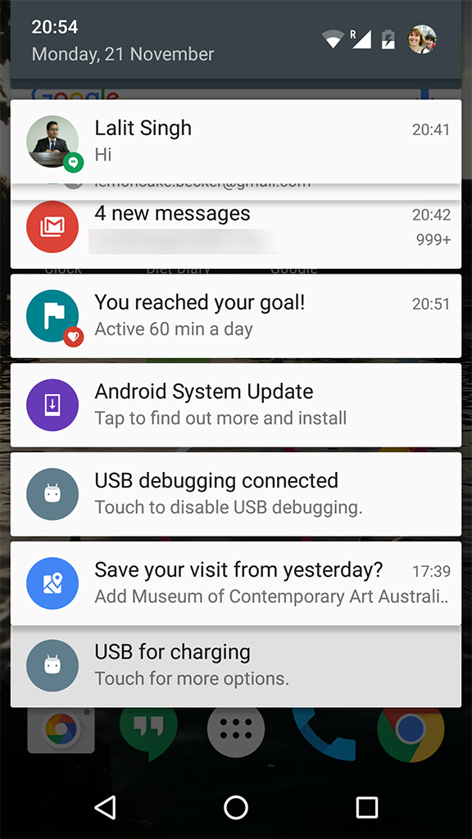
How are notifications used?
Android issues a notification that appears as icon
To see details, user opens the notification drawer
User can view notifications any time in the notification drawer

Slide 7
Creating Notifications

Slide 8
Building a Notification
Two classes
NotificationCompat.Builder
Specifies UI and actions
NotificationCompat.Builder.build() creates the Notification
NotificationManager / NotificationManagerCompat
NotificationManager.notify() issues the notification

Slide 9
Building a Notification
Define variables
private NotificationCompat.Builder mNotifyBuilder;
private NotificationManager mNotifyManager;
private static final int NOTIFICATION_ID = 0

Slide 10
Building a Notification
Instantiate NotificationManager
In onCreate() of activity
mNotifyManager = (NotificationManager)
getSystemService(NOTIFICATION_SERVICE);

Slide 11
Building a Notification
Build and send notification
Define notification and set required attributes
mNotifyBuilder = new NotificationCompat.Builder(this)
.setContentTitle("You've been notified!")
.setContentText("This is your notification text.")
.setSmallIcon(R.drawable.ic_android_black_24dp);
Notification myNotification = mNotifyBuilder.build();
mNotifyManager.notify(NOTIFICATION_ID, myNotification);

Slide 12
Actions and Pending Intents

Slide 13

User actions
Notifications must be able to perform actions on behalf of your application
Include specific actions inside the Notification UI
Launch action when the notification is tapped
OK for the action to just open an Activity in your app

Slide 14
Pending intents
A PendingIntent is a description of an intent and target action to perform with it
Give a PendingIntent to another application to grant it the right to perform the operation you have specified as if the other application was yourself

Slide 15
Pending Intents for Notifications
Content intent is activated when the notification is tapped
setContent()
Actions are choices shown to user
setAction()

Slide 16
Methods to create a PendingIntent
Use method that corresponds to intent
PendingIntent.getActivity()
PendingIntent.getBroadcast()
PendingIntent.getService()

Slide 17
Methods all take four arguments
Application context
Request code—constant integer id for the pending intent
Intent to be delivered
PendingIntent flag determines how the system handles multiple pending intents from same app

Slide 18
Step 1: Create intent
Intent notificationIntent =
new Intent(this, MainActivity.class);

Slide 19
Step 2: Create PendingIntent
PendingIntent notificationPendingIntent =
PendingIntent.getActivity(
this, NOTIFICATION_ID,
notificationIntent, PendingIntent.FLAG_UPDATE_CURRENT);

Slide 20
Step 3: Add to notification builder
.setContentIntent(notificationPendingIntent);

Slide 21

Add action buttons
Use NotificationCompat.Builder.addAction() — pass in icon, caption, PendingIntent
.addAction(R.drawable.ic_color_lens_black_24dp, "R.string.label", notificationPendingIntent);

Slide 22
Priority and Defaults

Slide 23
Notification priority
Determines how the system displays the notification with respect to other notifications
Use NotificationCompat.Builder.setPriority() —pass in priority level
.setPriority(NotificationCompat.PRIORITY_HIGH)

Slide 24
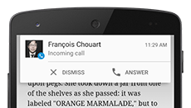
5 notification priority levels
PRIORITY_MIN (-2) to PRIORITY_MAX (2)
Priority above 0 triggers heads-up notification on top of current UI
Used for important notifications such as phone calls
Use lowest priority possible

Slide 25
Notification defaults
Set sounds, vibration, and LED color pattern
.setDefaults(NotificationCompat.DEFAULT_ALL)

Slide 26
Common Layouts

Slide 27
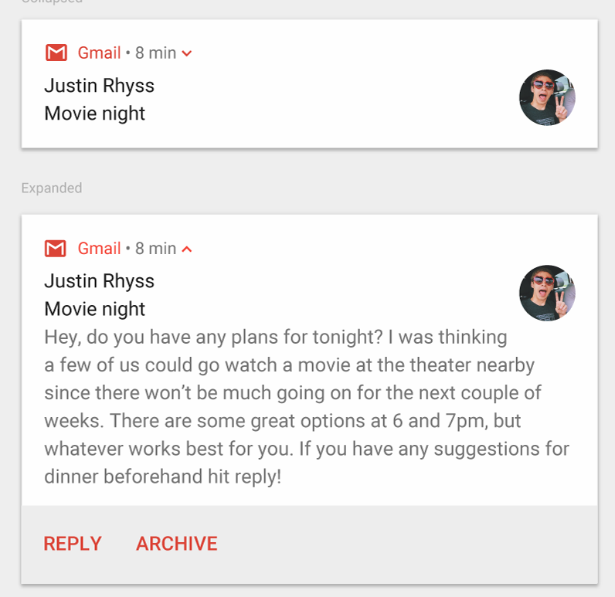
Big text
More text than will fit in standard view
NotificationCompat.BigTextStyle

Slide 28
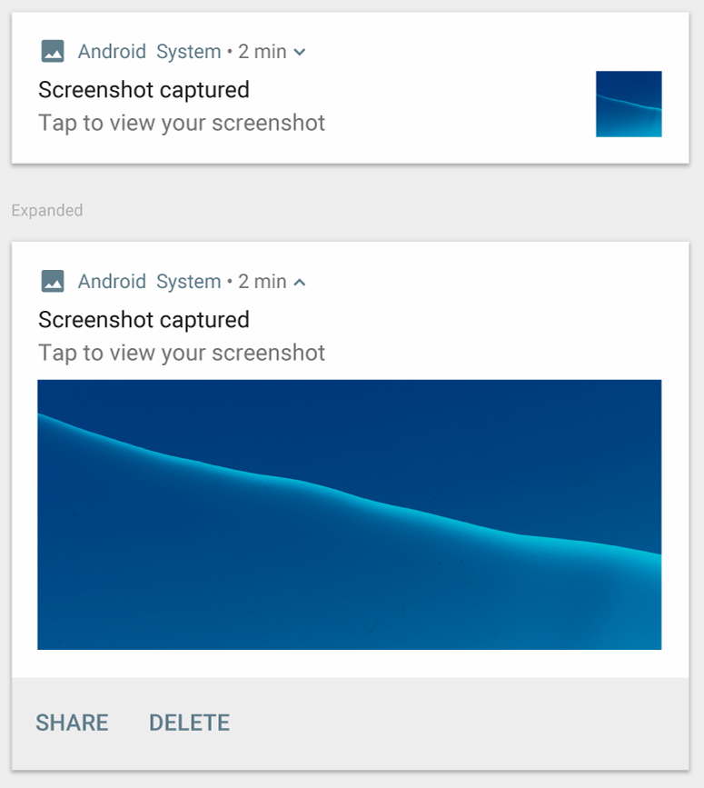
Big image
Include image with notification
NotificationCompa.BigPictureStyle

Slide 29
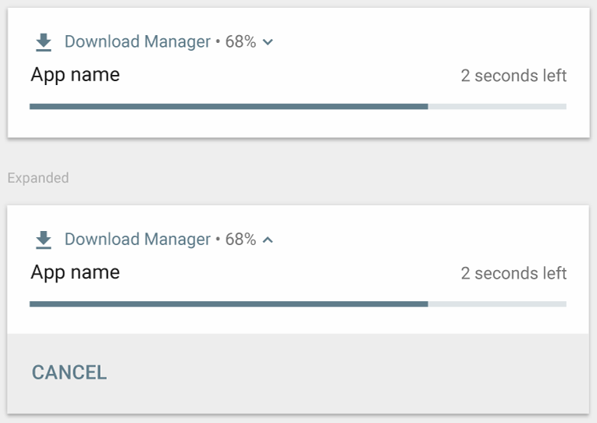
Progress bar
Progress bar for ongoing task that can be cancelled
Not a style
.setProgress(100, incr, false)

Slide 30
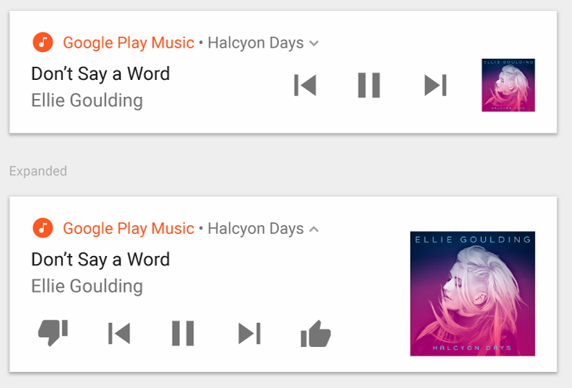
Media
Actions for controlling media such as music with image for album cover
NotificationCompat.MediaStyle

Slide 31
Managing Notifications
Setting styles
mNotifyBuilder
.setStyle(new NotificationCompat.BigPictureStyle()
.bigPicture(myBitmapImage)
.setBigContentTitle("Notification!"));

Slide 32
Managing Notifications

Slide 33
Managing Notifications
Updating notifications
Issue notification with updated parameters using builder
Call notify() passing in the same notification ID
If previous notification is still visible, system updates
If previous notification has been dismissed, new notification is created

Slide 34
Managing Notifications
Canceling notifications
Users can dismiss notifications
User launches Content Intent with setAutoCancel() enabled
App calls cancel() or cancelAll() on NotificationManager
mNotifyManager.cancel(NOTIFICATION_ID);

Slide 35
Design guidelines
If your app sends too many notifications, users will disable notifications or uninstall the app
Notifications design guide

Slide 36
Learn more
Notifications
Notification Design Guide
NotificationCompat.Builder
NotificationCompat.Style

Slide 37
What's Next?
Concept Chapter: 8.1 C Notifications
Practical: 8.1 P Notifications

Slide 38
The End

